Slide 1

Customer Shopping Behavior Analysis
This project analyzes 3,900 customer purchases to uncover insights into spending patterns, segments, product preferences, and subscription behavior. Our goal is to guide strategic business decisions.

Slide 2

Project Overview
1
2
Data-Driven Insights
Key Areas
Analyze transactional data from 3,900 purchases.
Focus on spending patterns, customer segments, product preferences, and subscriptions.
3
Strategic Guidance
Provide actionable recommendations for business growth.

Slide 3

Dataset Summary
Our dataset comprises 3,900 rows and 18 columns, capturing a comprehensive view of customer interactions.
Rows: 3,900
Columns: 18
Missing Data: 37 values in Review Rating

Slide 4


Key Features
Customer Demographics
Age, Gender, Location, Subscription Status.
Purchase Details
Item, Category, Amount, Season, Size, Color.
Shopping Behavior
Discount, Promo, Previous Purchases, Frequency, Review, Shipping Type.

Slide 5
Exploratory Data Analysis (Python)
01
02
03
Data Loading & Exploration
Missing Data Handling
Column Standardization
Imported dataset with Pandas, checked structure and summary statistics.
Imputed missing 'Review Rating' values using median per category.
Renamed columns to snake case for readability.
04
05
Feature Engineering
Database Integration
Created 'age_group' and 'purchase_frequency_days' columns.
Loaded cleaned data into PostgreSQL for SQL analysis.

Slide 6

Data Analysis (SQL)
Key business questions answered through structured SQL analysis:
Revenue by Gender
High-Spending Discount Users
Male customers generated $157,890, females $75,191.
839 customers used discounts but spent above average.
Top 5 Products by Rating
Gloves (3.86), Sandals (3.84), Boots (3.82), Hat (3.80), Skirt (3.78).

Slide 7

SQL Insights: Spending & Loyalty
Shipping Type Comparison: Express shipping had a higher average purchase amount ($60.48) than Standard ($58.46).
Subscribers vs. Non-Subscribers: Non-subscribers (2847) had higher total revenue ($170,436) than subscribers (1053, $62,645).
Discount-Dependent Products: Hat (50%), Sneakers (49.66%), Coat (49.07%), Sweater (48.17%), Pants (47.37%) had the highest discount rates.

Slide 8
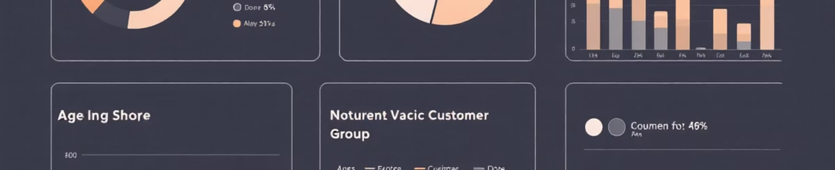
Customer Segmentation & Age Group Revenue
Customer Segments
Top Products per Category
Revenue by Age Group
Loyal (3116), Returning (701), New (83).
Jewelry, Blouse, Sandals, Jacket lead their categories.
Young Adults ($62,143) contribute the most revenue.

Slide 9
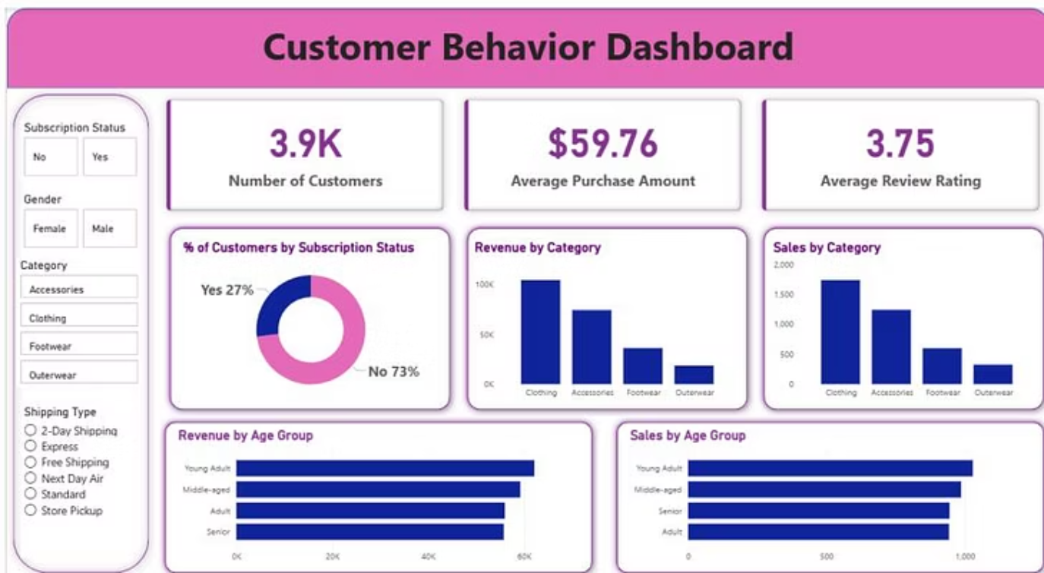
Power BI Dashboard
An interactive Power BI dashboard visualizes key insights:
3.9K Customers
$59.76 Average Purchase Amount
3.75 Average Review Rating
73% Non-Subscribers vs. 27% Subscribers

Slide 10

Business Recommendations
Boost Subscriptions
Promote exclusive benefits to increase subscriber base.
Customer Loyalty Programs
Reward repeat buyers to foster loyalty and retention.
Review Discount Policy
Optimize discount strategies to balance sales and profit margins.
Targeted Marketing
Focus campaigns on high-revenue age groups and express-shipping users.

